Slide 1

MACHINE LEARNING
UNIT – III
ENSEMBLE TECHNIQUES
AND UNSUPERVISED LEARNING

Slide 2
COMBINING MULTIPLE LEARNERS
Combining multiple learners is a machine learning technique that combines multiple
models into a single model. The goal is to improve the model's performance by
combining the weak learners in the right way.
Rationale :
• The No Free Lunch Theorem states that there is no single learning algorithm that in any
domain always induces the most accurate learner. The usual approach is to try many and
choose the one that performs the best on a separate validation set.
Different Learners use Different
• Algorithms: making different assumptions
• Hyper parameters: e.g. number of hidden nodes in NN, k in k-NN
• Representations: different features, multiple sources of information
Training sets: small variations in the sets or different subproblems

Slide 3
COMBINING MULTIPLE LEARNERS
Different Algorithms
Different algorithms make different assumptions about the data and lead to
different classifiers.
Different Hyper parameters
Use the same learning algorithm but use it with different hyper parameters.
Different Input Representations
Separate base-learners may be using different representations of the same input object or event, making it possible to integrate different types of Sensors/ measurements/ modalities.
Different representations make different characteristics explicit allowing better identification.
Different Training Sets
Another possibility is to train different base-learners by different subsets of the training set. This can be done randomly by drawing random training sets from the given sample this is called bagging.

Slide 4
COMBINING MULTIPLE LEARNERS
Model Combination Schemes
There are also different ways the multiple base-learners are combined to generate
the final output:
Multi expert combination
Multi expert combination methods have base-learners that work in parallel methods
can in turn be divided into two:
The global approach, also called learner fusion, given an input, all base-learners
generate an output and all these outputs are used.
Examples are voting and stacking.
B) The local approach, or learner selection, for example, in mixture of experts, there
is a gating model, which looks at the input and chooses one (or very few) of the learners
as responsible for generating the output.

Slide 5

COMBINING MULTIPLE LEARNERS
1. Serial Approach:
Next base-learner focuses on instances where previous base-learners are inaccurate.
2. Base Learners:
𝐿: Number of base-learners. 𝑑𝑗(𝑥)d j​ (x): Prediction from base-learner 𝑀𝑗 for input 𝑥.
3. Input Representation:
Each learner 𝑀𝑗M j​ uses a unique input representation 𝑥𝑗x j​ , possibly with transformations.
4. Final Prediction:
Predictions from base-learners are combined using a function: 𝑌=𝑓(𝑑1,𝑑2,…,𝑑𝐿∣Φ)
𝑓(⋅): Combining function. Φ: Parameters of the combining function.
5. Multi-Class Classification:
𝐾: Number of output classes. Each learner 𝑀𝑗 generates 𝐾 predictions, 𝑑𝑗𝑖(𝑥).
Combine predictions to produce final 𝐾 values, 𝑦𝑖.
6. Classification Decision:
Predicted class: Class with the maximum 𝑦𝑖 value is chosen.

Slide 6
COMBINING MULTIPLE LEARNERS
Voting :
• A Voting Classifier is a machine learning model that trains on an ensemble of numerous models and predicts an output (class) based on their highest probability of chosen
as the output.
• It simply aggregates the findings of each classifier passed into Voting Classifier and
predicts the output class based on the highest majority of voting.
• The idea is instead of creating separate dedicated models and finding the accuracy for
each them, create a single model which trains by these models and predicts output based
on their combined majority of voting for each output class.
• The simplest way to combine multiple classifiers is by voting, which corresponds to
taking a linear combination of the learners .
• This is also known as ensembles. In the simplest case, all learners are given equal weight
and simple voting corresponds to take an average.

Slide 7
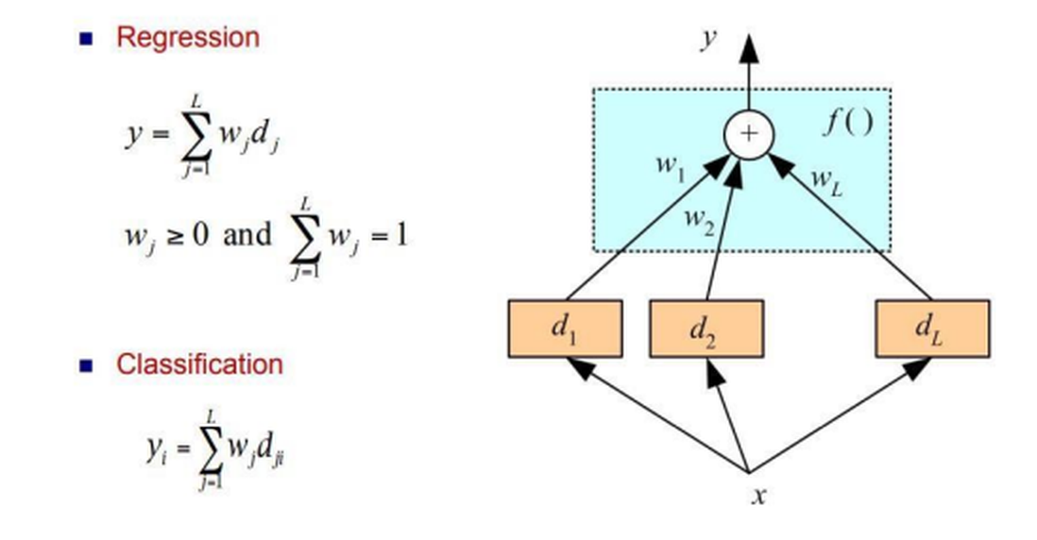
COMBINING MULTIPLE LEARNERS
• Voting Classifier supports two types of voting’s.

Slide 8
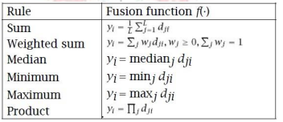
COMBINING MULTIPLE LEARNERS
Hard Voting:
Predicts the class with the highest majority of votes from classifiers.
Example: If three classifiers predict (A, A, B), the majority is A,becomes the final prediction.
2. Soft Voting:
Predicts the class based on the average probability assigned by classifiers.
Example:
Class A probabilities: (0.30, 0.47, 0.53) → Average = 0.4333.
Class B probabilities: (0.20, 0.32, 0.40) → Average = 0.3067.
Winner: Class A due to higher average probability.
3. Bayesian Interpretation:
Voting schemes approximate a Bayesian framework
Classifier weights represent prior model probabilities, and model decisions approximate conditional likelihoods.

Slide 9

COMBINING MULTIPLE LEARNERS
Bayesian model combination:
Different Algorithms
Different algorithms make different assumptions about the data and lead to
different classifiers.
Different Hyper parameters
Use the same learning algorithm but use it with different hyper parameters.
Different Input Representations
Separate base-learners may be using different representations of the same input object or event, making it possible to integrate different types of Sensors/ measurements/ modalities.
Different representations make different characteristics explicit allowing better identification.
Different Training Sets
Another possibility is to train different base-learners by different subsets of the training set. This can be done randomly by drawing random training sets from the given sample this is called bagging.

Slide 10
ENSEMBLE LEARNING TECHNIQUE
Ensemble learning Technique :
"An ensembled model is a machine learning model that combines the predictions from two or
more models.”
• Ensemble learning is one of the most powerful machine learning techniques that use the combined output of two or more models/weak learners and solve a particular computational intelligence problem.
• E.g., a Random Forest algorithm is an ensemble of various decision trees combined.
• Ensemble learning is primarily used to improve the model performance, such as classification, prediction, function approximation, etc.
Simple Ensemble Training Methods typically just involve the application of statistical summary techniques, such as determining the mode, mean, or weighted average of a set of predictions.

Slide 11
ENSEMBLE LEARNING TECHNIQUE
Advanced Ensemble Training Methods :
• Bagging: Bagging is a method used to solve supervised machine learning problems.
• Boosting: Boosting is an ensemble method that enables each member to learn from the
preceding member's mistakes and make better predictions for the future.
• Stacking: Stacking is one of the popular ensemble modeling techniques in machine learning. Weak learners are ensembled in a parallel manner in that by combining them with Meta learners, we can predict better predictions for the future
Ensemble learning methods can be divided into one of two different groups:
1. Sequential methods
• Base learners/models are generated sequentially, the dependence between the base learners is exploited to get more accurate predictions. Eg: AdaBoost, XGBoost, and Gradient tree boosting.

Slide 12
ENSEMBLE LEARNING TECHNIQUE
Bagging Technique in Ensemble Learning :
Bagging is primarily used to solve supervised machine learning problems. Classified into:
• Bootstrapping: Random sampling method that is used to derive samples from the data
using the replacement procedure. First, random data samples are fed to the primary model, and then a base learning algorithm is run on the samples to complete the learning process.
• Aggregation: The process of combining the output of all base models and, based on their output, predicting an aggregate result with greater accuracy and reduced variance.
• Example: In the Random Forest method, predictions from multiple decision trees are ensembled parallelly. Further, in regression problems, we use an average of these predictions to get the final output, whereas, in classification problems, the model is selected as the predicted class.

Slide 13
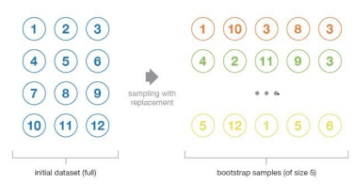
DECISION TREE
Implementation Steps of Bagging :
• Step 1: Multiple subsets are created from the original data set with equal tuples, selecting observations with replacement.
• Step 2: A base model is created on each of these subsets.
• Step 3: Each model is learned in parallel with each training set and independent of each other. • Step 4: The final predictions are determined by combining the predictions from all the models.

Slide 14
DECISION TREE
Boosting Technique in Ensemble learning :
• Boosting enables each member to learn from the preceding member's mistakes and make better predictions for the future.
• It is done by building a model by using weak models in series.
• Firstly, a model is built from the training data.
• Then the second model is built which tries to correct the errors present in the first model.
• This procedure is continued and models are added until either the complete training data set is predicted correctly or the maximum number of models is added.
• AdaBoost is short for Adaptive Boosting and is a very popular boosting technique that combines multiple “weak classifiers” into a single “strong classifier”.

Slide 15
DECISION TREE
Algorithm :
1. Initialize the dataset and assign equal weight to each of the data point.
2. Provide this as input to the model and identify the wrongly classified data points.
3. Increase the weight of the wrongly classified data points and decrease the
weights of correctly classified data points. And then normalize the weights of all
data points.
4. if (got required results)
Goto step 5
else
Goto step 2

Slide 16
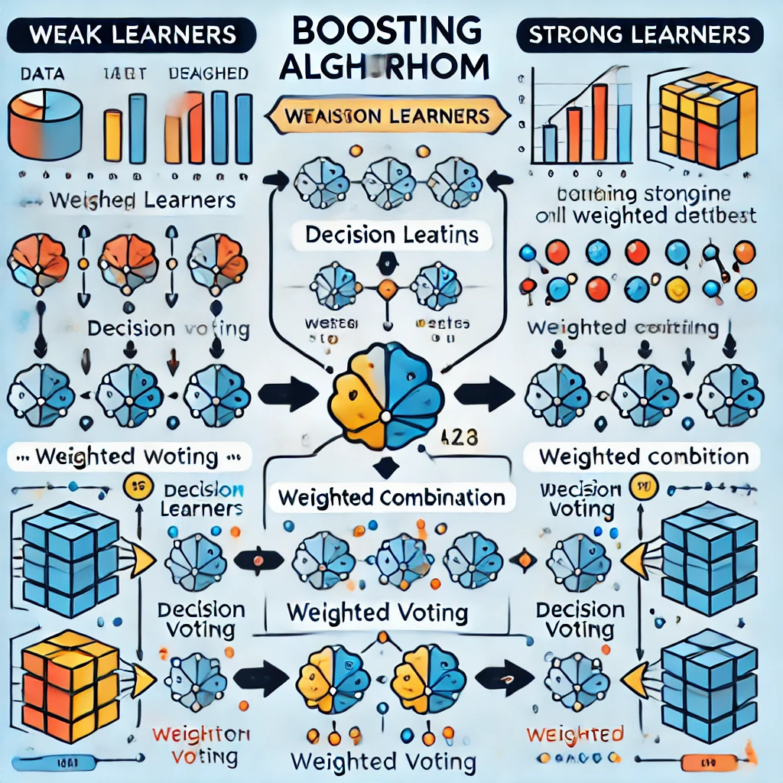
DECISION TREE
Fig. An illustration of the boosting algorithm, consisting of the parallel learners weighted dataset.

Slide 17
DECISION TREE
Algorithm :
1. Initialize the dataset and assign equal weight to each of the data point.
2. Provide this as input to the model and identify the wrongly classified data points.
3. Increase the weight of the wrongly classified data points and decrease the
weights of correctly classified data points. And then normalize the weights of all
data points.
4. if (got required results)
Goto step 5
Else
Goto step 2
Figure 3.4 An illustration presenting the intuition behind the boosting algorithm,
consisting of the parallel learners and weighted dataset.

Slide 18
DECISION TREE
Algorithm :
1. Initialize the dataset and assign equal weight to each of the data point.
2. Provide this as input to the model and identify the wrongly classified data points.
3. Increase the weight of the wrongly classified data points and decrease the
weights of correctly classified data points. And then normalize the weights of all
data points.
4. if (got required results)
Goto step 5
else
Goto step 2
Figure 3.4 An illustration presenting the intuition behind the boosting algorithm,
consisting of the parallel learners and weighted dataset.

Slide 19
DECISION TREE
THANK YOU…

